Slide 1
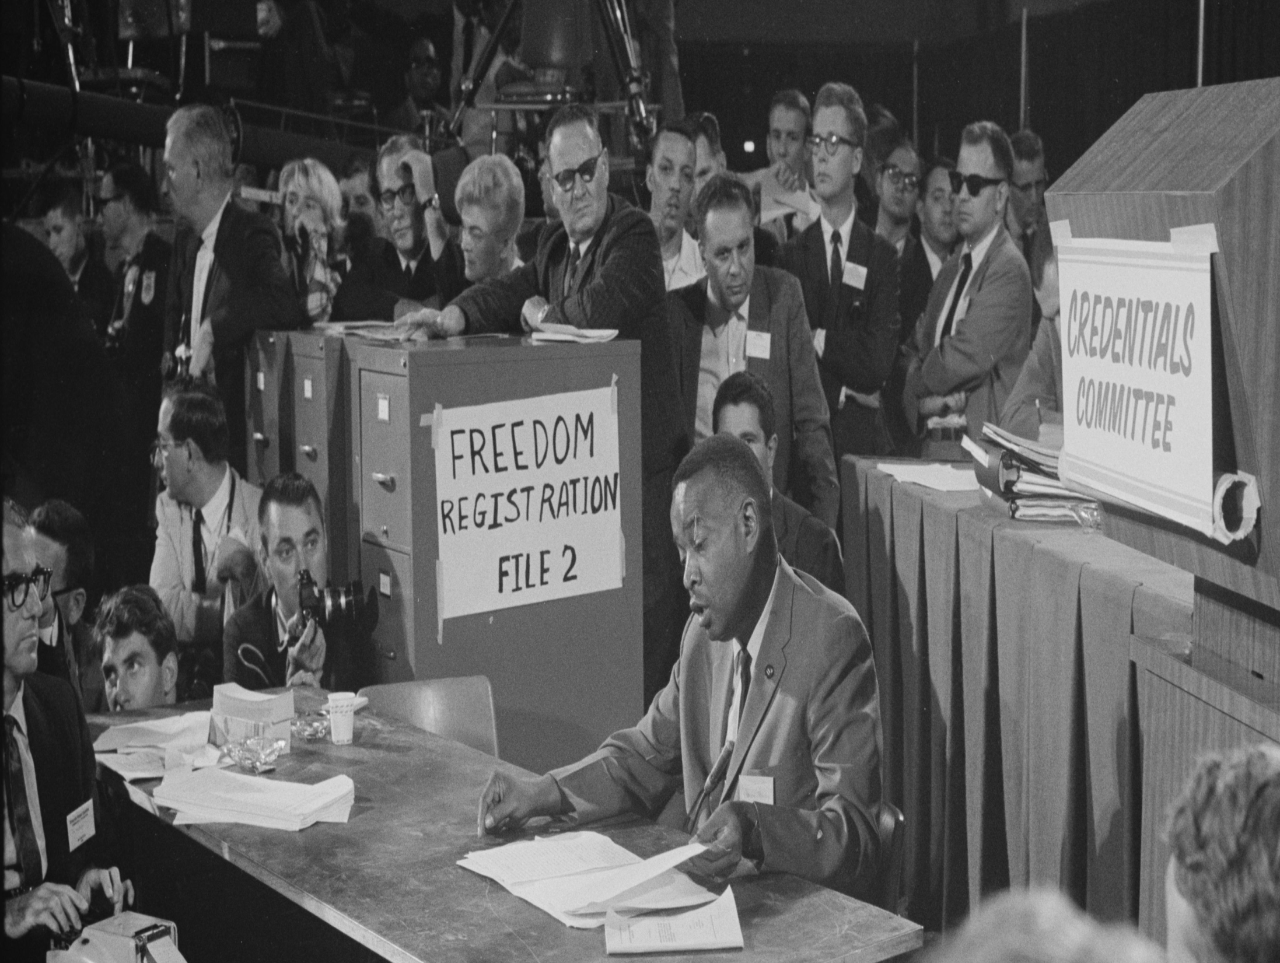
Small World Networks to Diffusion of Innovation: A Social Network Analysis of Mississippi’s Freedom Summer Project
Freedom Summer By, Doug McAdam
Langford Wiggins
SNA Fall 2013

Slide 2
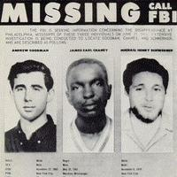
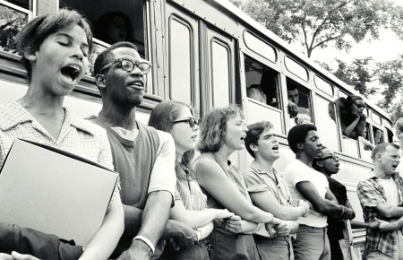
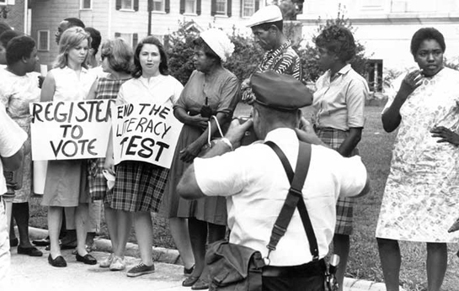
Rationale

Slide 3
Background
Student Nonviolent Coordination Committee (SNCC) recalled the Freedom Voter Campaign, (FVC) summer prior to 1964, where SNCC sought out assistance from white northern college students to help register black Mississippians to vote.
In an effort to expand FVC, SNCC recruited 750 volunteers to partake in the Freedom Summer Project that would enact civic duty nationally and alter the societal standards of the Sixties.

Slide 4
Methodology
Social Network Analysis was conducted focusing on the presence and impact of various organizations during the Freedom Summer Project. Going chapter by chapter capturing the relationships described in Freedom Summer, the goal is to educate viewers about the Freedom Summer Project and to show, in effect, how graphs facilitate learning. The impact of small world networks will be conceptualized by examining the relationship and civic involvement of organizations, government parties and corporations.

Slide 5
Chapter 1

Slide 6
Chapter 2

Slide 7
Chapter 3

Slide 8
Chapter 4

Slide 9
Chapter 5

Slide 10
Chapter 6

Slide 11
Key Components
Media
Black Churches
Parents of Volunteers
Volunteers not from elite schools (e.g. doctors, ministers, psychologists, and lawyers)

